Slide 1
Real time braking system and monitoring using AUTOSAR communication stack
By : Hossam Magdy Afifi

Slide 2
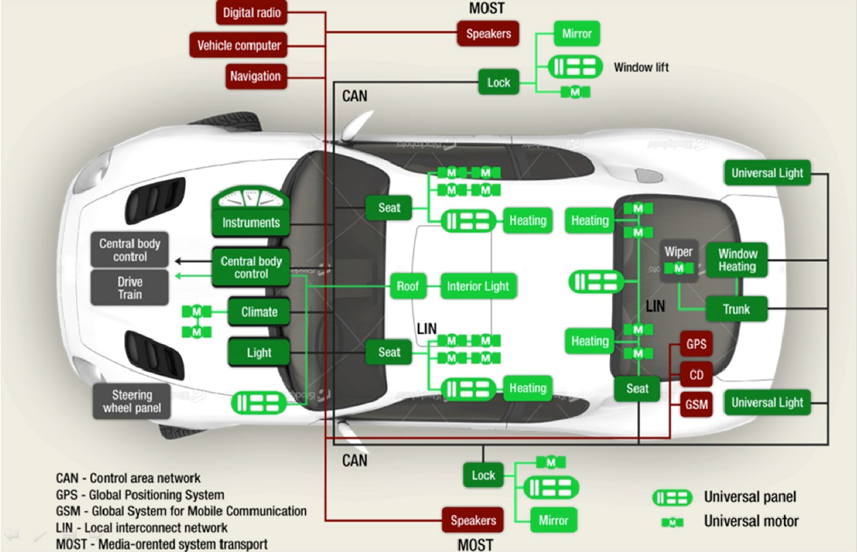
System Architecture
We aim to imitating real scenario in the automotive industry

Slide 3
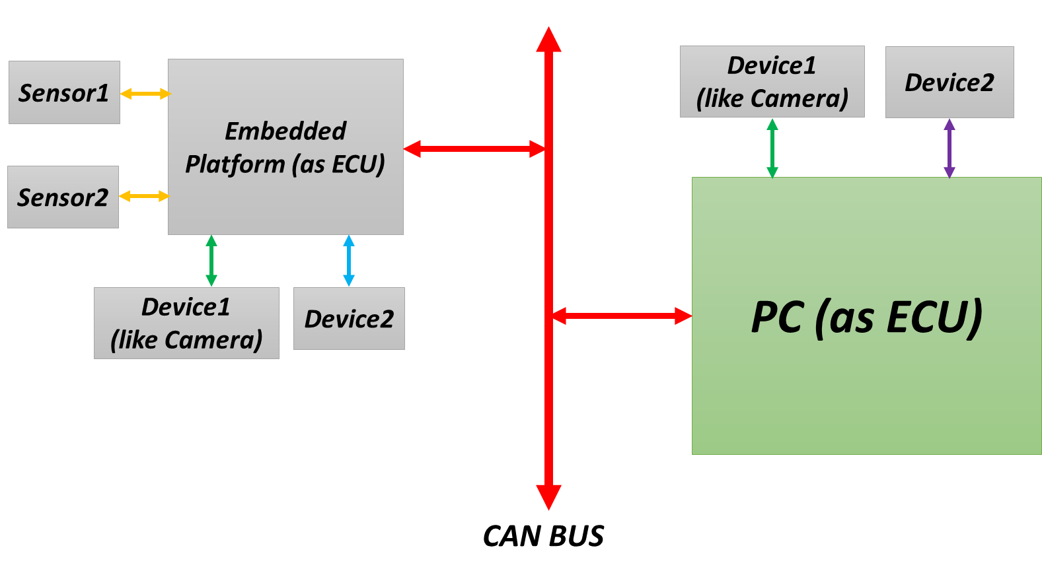
System Architecture

Slide 4
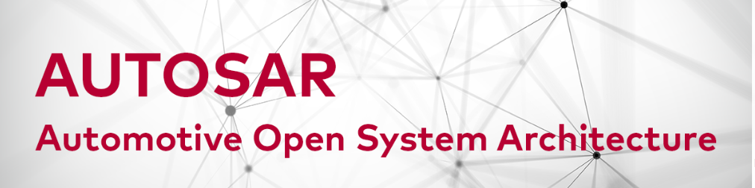

Slide 5


Slide 6
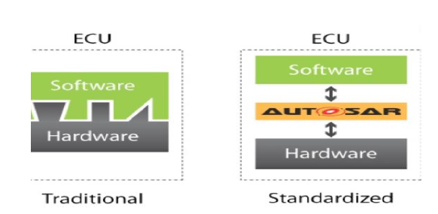
AUTOSAR
AUTomotive Open System ARchitecture is a standardized automotive software architecture
The main target of Autosar:
Improve software quality and reduce costs and time through reusing
SWC application are completely independent from hardware
Reuse development method and tools
Reuse of basic software

Slide 7
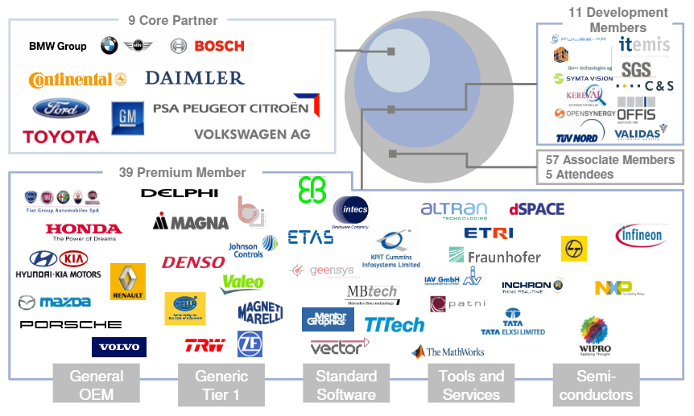
AUTOSAR partnership

Slide 8
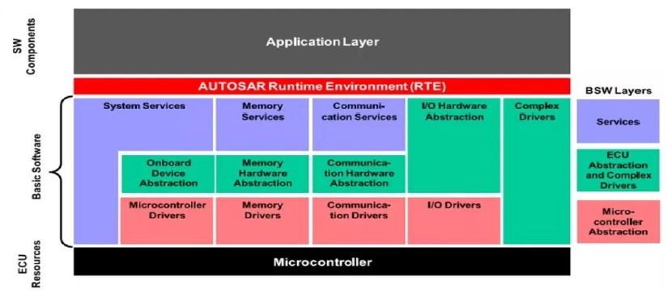
AUTOSAR Stack

Slide 9
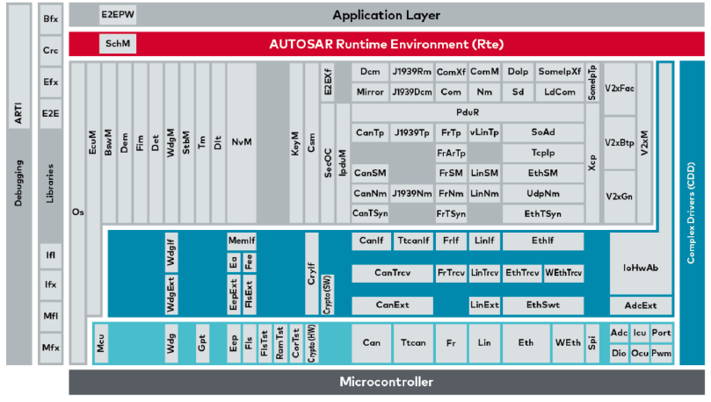
AUTOSAR Stack Cont..

Slide 10
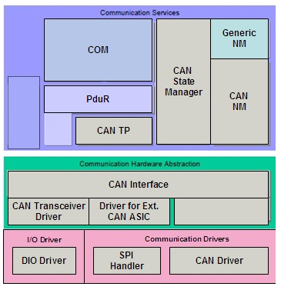
AUTOSAR Communication Stack
TX flow
RX flow

Slide 11
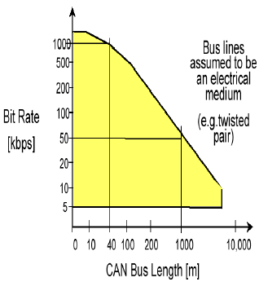
CAN
Main Features:
CAN stands for Controller Area Network
Serial communication protocol
High level of error handling
Multi Master Multi Slave communication

Slide 12
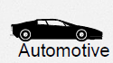
CAN
CAN Application:
Motor vehicles
Industrial automation
Other application of CAN are:
Office Automation
Trains
Medical Equipment
Building Automation

Slide 13
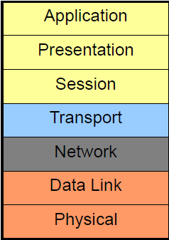
CAN
Initially developed for motor vehicles by Robert Bosch GmbH, Germany, starting 1983, also holding the CAN license.
CAN protocol follows OSI Reference model
Types CAN Protocol :
Standard CAN
Extended CAN
Notes:
OSI (Open System Interconnect)

Slide 14


Slide 15


